Slide 1
The Survey on MPC and PSI
Secure multi-party computation and private set intersection.

Slide 2
Secure and Verifiable computation
Outsourced computation
One party owns the data and wants to be able to obtain the result of computation on that data.
Another party receives and stores the encrypted data.
The data owner can then decrypt the returned results to obtain the output.
Homomorphic Encryption, partially-HE(Add or Multi) and Fully-HE(Add and Multi)
Multi-party computation
All of protocol participants are data owners.

Slide 3
Comparison of FHE and MPC
FHE offers an asymptotic communication improvement, but is computational more expensive.
In some applications, FHE are thousands of times slower
Performance Both depends on the tradeoff between computation and bandwidth.

Slide 4
Introduction of MPC
Types
Generic MPC, for computing any discrete functions can be represented as a fixed-size circuit.
Specialized MPC, for specific functionalities. More efficient than the best generic protocols.
Applications：
Auction, voting and Machine Learning.
Stable matching and spam filtering.
contact discovery(PSI)
Do I know you? – Efficient and Privacy-Preserving Common Friend-Finder Protocols and Applications

Slide 5
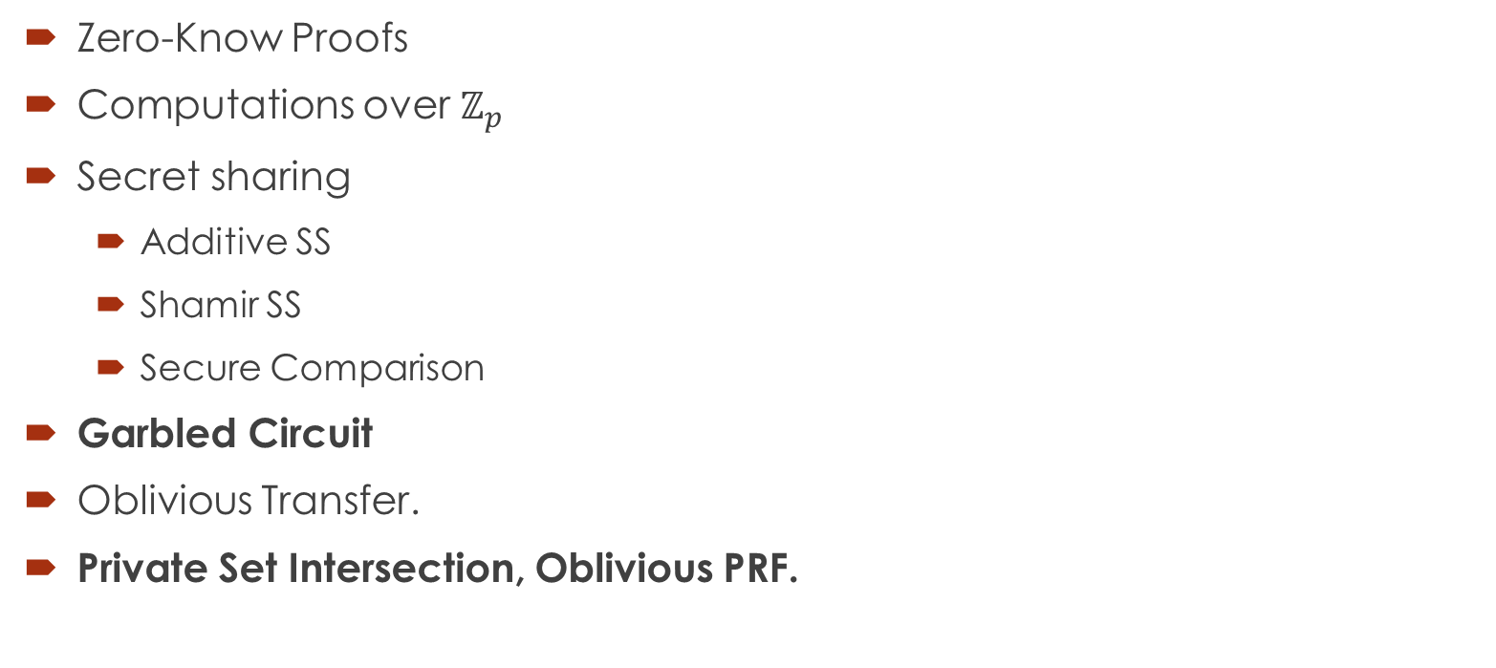
Fundamental MPC Protocols
Zero-Know Proofs
Computations over $ℤ_{p}$
Secret sharing
Additive SS
Shamir SS
Secure Comparison
Garbled Circuit
Oblivious Transfer.
Private Set Intersection, Oblivious PRF.

Slide 6
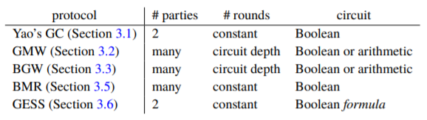
MPC Protocols
Important MPC approaches
Yao’s GC
Goldreich-Micali-Wigderson (GMW) Protocol
Players hold additive shares of the active wire value
BGM protocol:Based on Shamir secret sharing.
Constant-Round Multi-Party Computation: BMR.

Slide 7
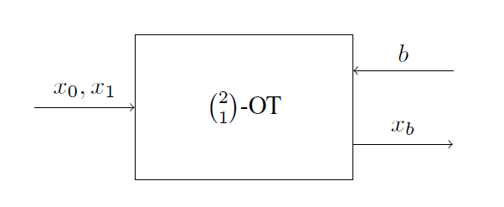
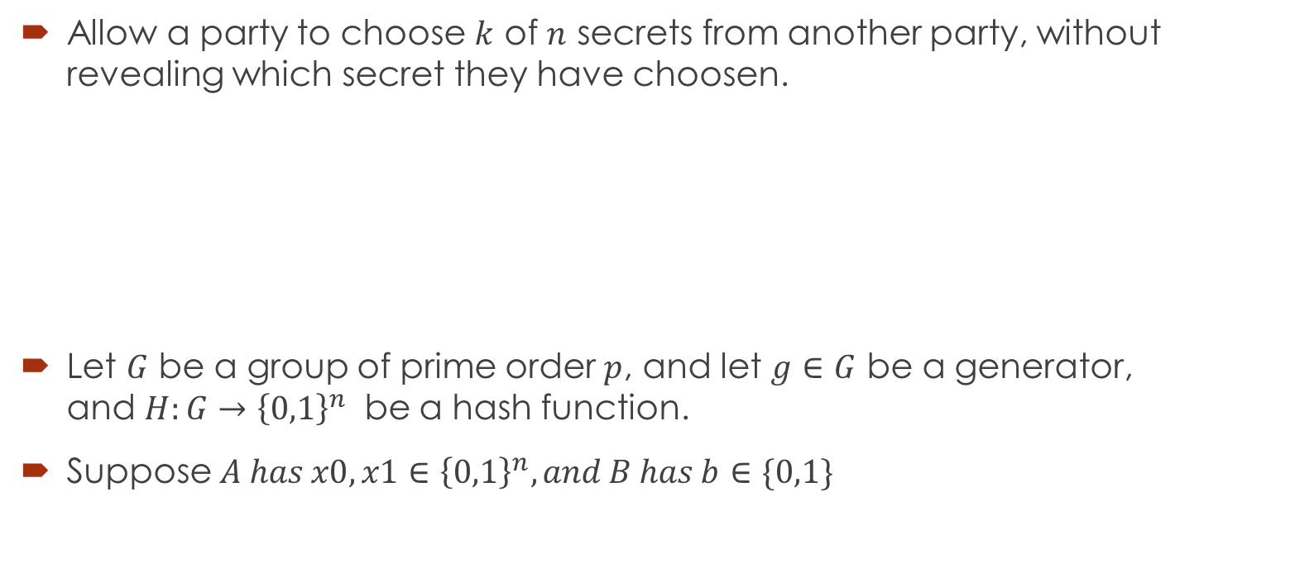
Oblivious Transfer (OT)
Allow a party to choose $k$ of $n$ secrets from another party, without revealing which secret they have choosen.
Let $G$ be a group of prime order $p$, and let $g∈G$ be a generator, and $H:G→{\left\{0,1\right\}}^{n}$ be a hash function.
Suppose $A has x0,x1∈{\left\{0,1\right\}}^{n}, and B has b∈\{0,1\}$

Slide 8

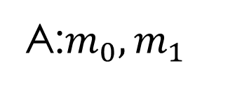


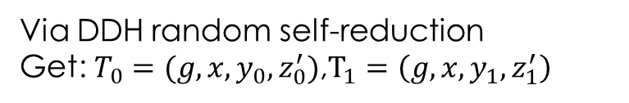

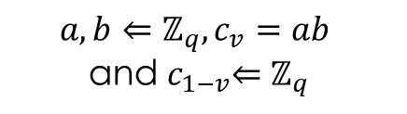
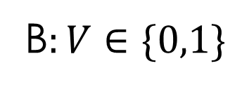

OT: Naor-Pinkas construction
Random Self-reduction: We have tuple $\left(g, g^{x}, g^{y}, g^{z}\right)$, Then to perform a random self reduction. Pick random $a, b←ℤ_{P}^{∗}$, and output $g, g^{\left(x+b\right)a}$,$g^{y}$,$g^{\left(z+by\right)a}$.
A:$m_{0},m_{1}$
B$:V∈\{0,1\}$
$$(g, x=g^{a},y=g^{b}, z_{0}=g^{c_{0}},z_{1}=g^{c_{1}})$$
$$a, b⇐ℤ_{q},c_{v}=ab$$
and${ c}_{1−v}⇐ℤ_{q}$
Via DDH random self-reduction
Get: $T_{0}=(g,x,y_{0},z_{0}^{′})$,$T_{1}=\left(g, x, y_{1},z_{1}^{′}\right)$
$$({CT}_{0}=(y_{0},mz_{0}^{′}), {CT}_{1}=(y_{1},mz_{1}^{′}))$$
Enc($m_{0}, T_{0}$) and Enc$(m_{1},T_{1})$
Decrypt $CT_{v}$

Slide 9
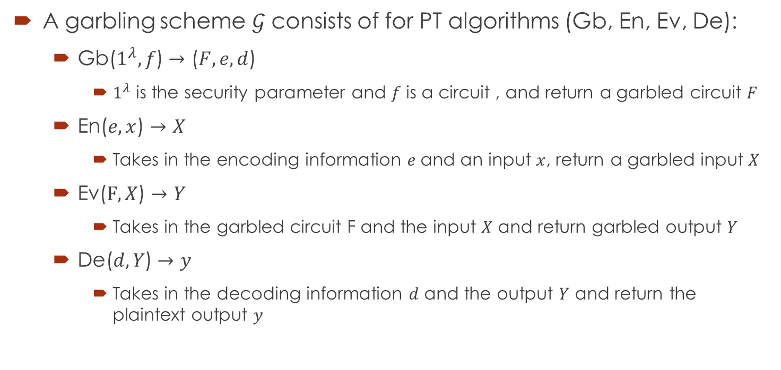
Garbled Circuits-Garbling Scheme
A garbling scheme $𝒢$ consists of for PT algorithms (Gb, En, Ev, De):
Gb($1^{λ}, f$) $→$ ($F, e, d$)
$1^{λ}$ is the security parameter and $f$ is a circuit , and return a garbled circuit $F$
En($e, x$) $→$ $X$
Takes in the encoding information $e$and an input $x$, return a garbled input $X$
Ev($F, X$) $→$ $Y$
Takes in the garbled circuit F and the input $X$ and return garbled output $Y$
De($d, Y$) $→$ $y$
Takes in the decoding information $d$ and the output $Y$ and return the plaintext output $y$

Slide 10
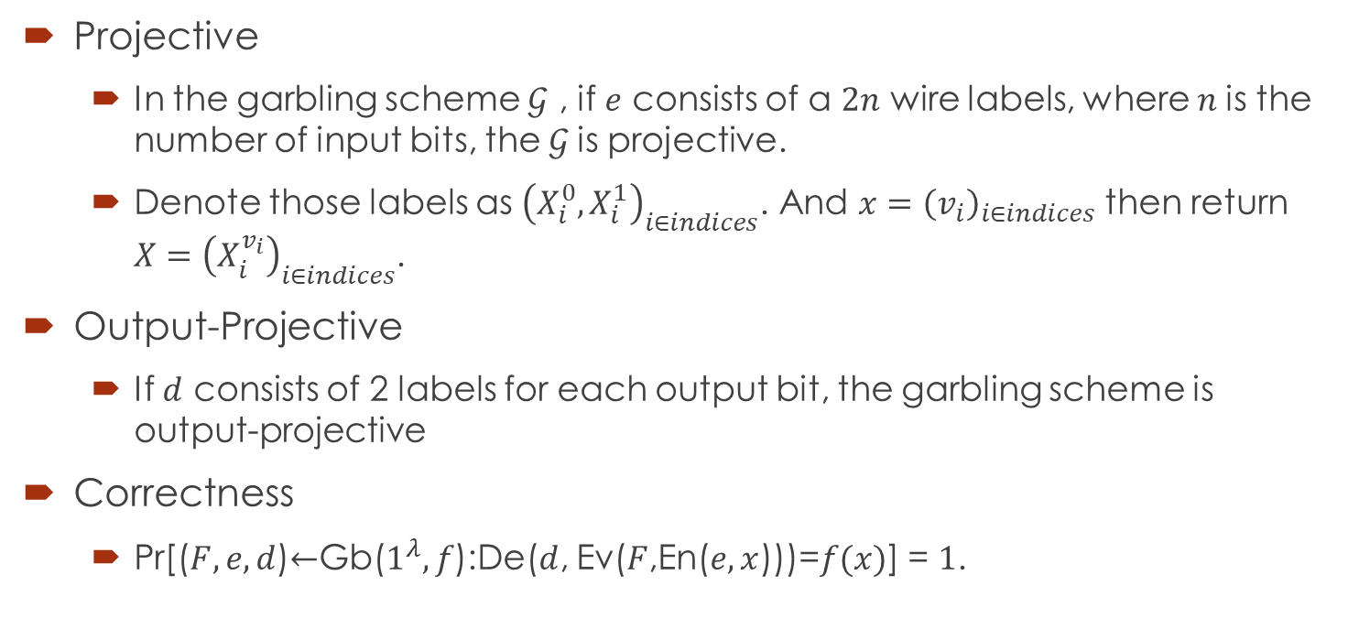
Garbled Circuit-projective
Projective
In the garbling scheme $𝒢$ , if $e$ consists of a $2n$ wire labels, where $n$is the number of input bits, the $𝒢$is projective.
Denote those labels as ${\left(X_{i}^{0}, X_{i}^{1}\right)}_{i∈indices}$. And $x={\left(v_{i}\right)}_{i∈indices}$ then return $X={\left(X_{i}^{v_{i}}\right)}_{i∈indices}$.
Output-Projective
If $d$ consists of 2 labels for each output bit, the garbling scheme is output-projective
Correctness
Pr[($F,e,d$)$←$Gb($1^{λ},f$):De($d$, Ev($F$,En($e, x$)))=$f(x)$] = $1$.

Slide 11
Garbled Circuit Methods for PSI
PSI: Private set Intersection

Slide 12
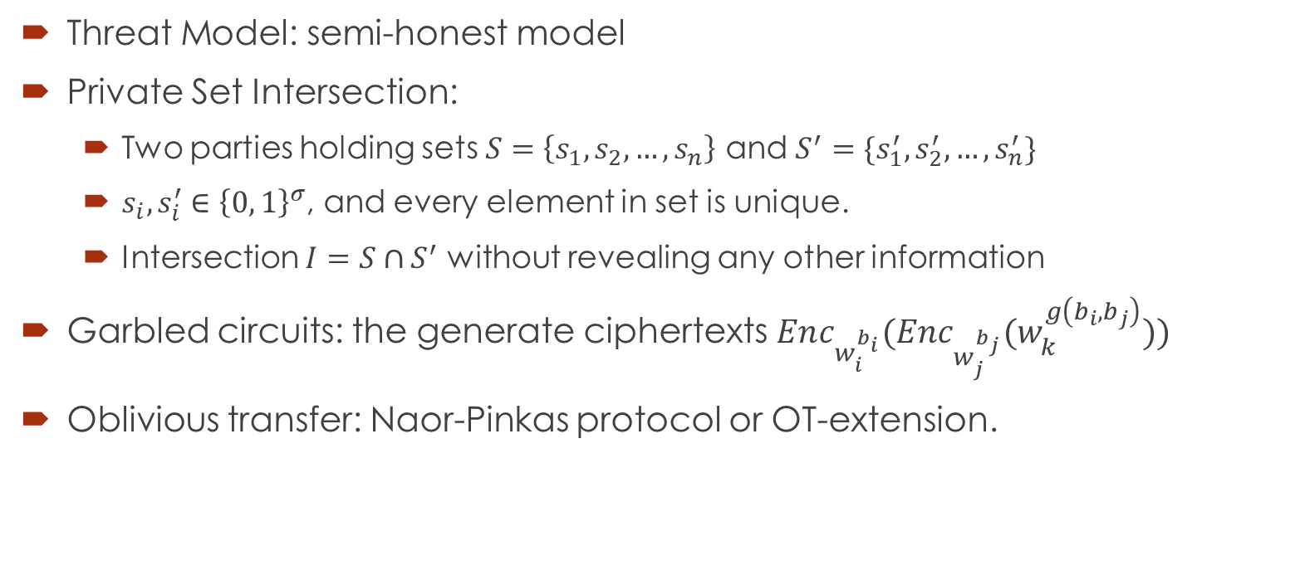
Background
Threat Model: semi-honest model
Private Set Intersection:
Two parties holding sets $S=\left\{s_{1}, s_{2}, …,s_{n}\right\}$ and $S^{′}=\{s_{1}^{′},s_{2}^{′},…,s_{n}^{′}\}$
$s_{i}, s_{i}^{′}∈{\left\{0, 1\right\}}^{σ}$, and every element in set is unique.
Intersection $I=S∩S^{′}$ without revealing any other information
Garbled circuits: the generate ciphertexts $Enc_{w_{i}^{b_{i}}}(Enc_{w_{j}^{b_{j}}}(w_{k}^{g\left(b_{i}, b_{j}\right)}))$
Oblivious transfer: Naor-Pinkas protocol or OT-extension.

Slide 13
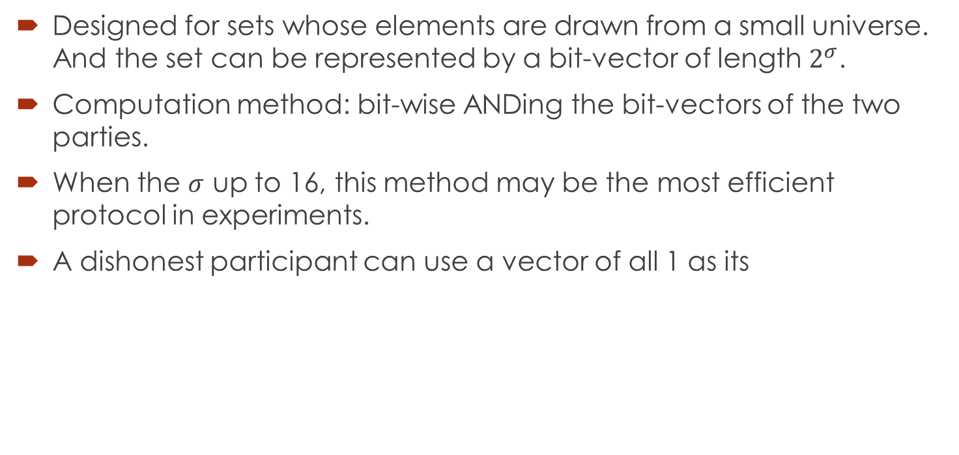
Bitwise-AND(BWA)
Designed for sets whose elements are drawn from a small universe. And the set can be represented by a bit-vector of length $2^{σ}$.
Computation method: bit-wise ANDing the bit-vectors of the two parties.
When the $σ$ up to 16, this method may be the most efficient protocol in experiments.
A dishonest participant can use a vector of all 1 as its

Slide 14
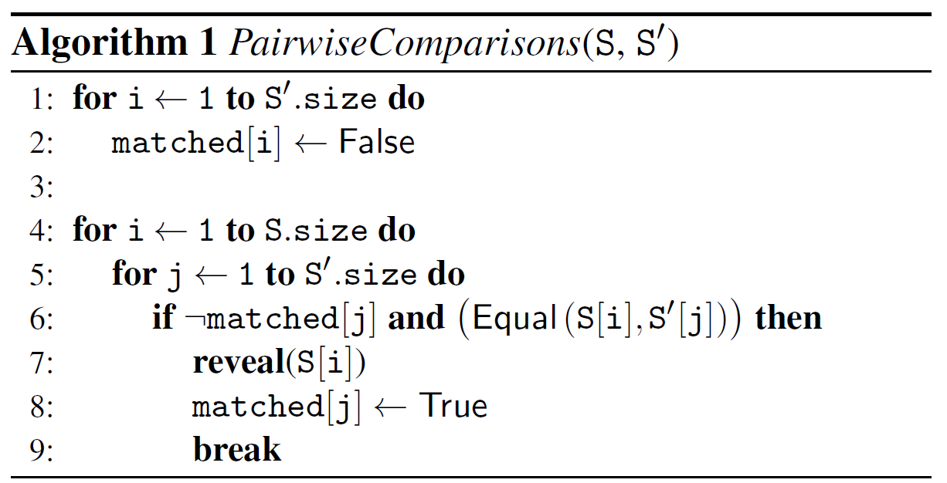

Pairwise-Compare(PWC)
Requires $Θ\left(n^{2}\right)$ comparisons.
Two thread, main and reveal

Slide 15
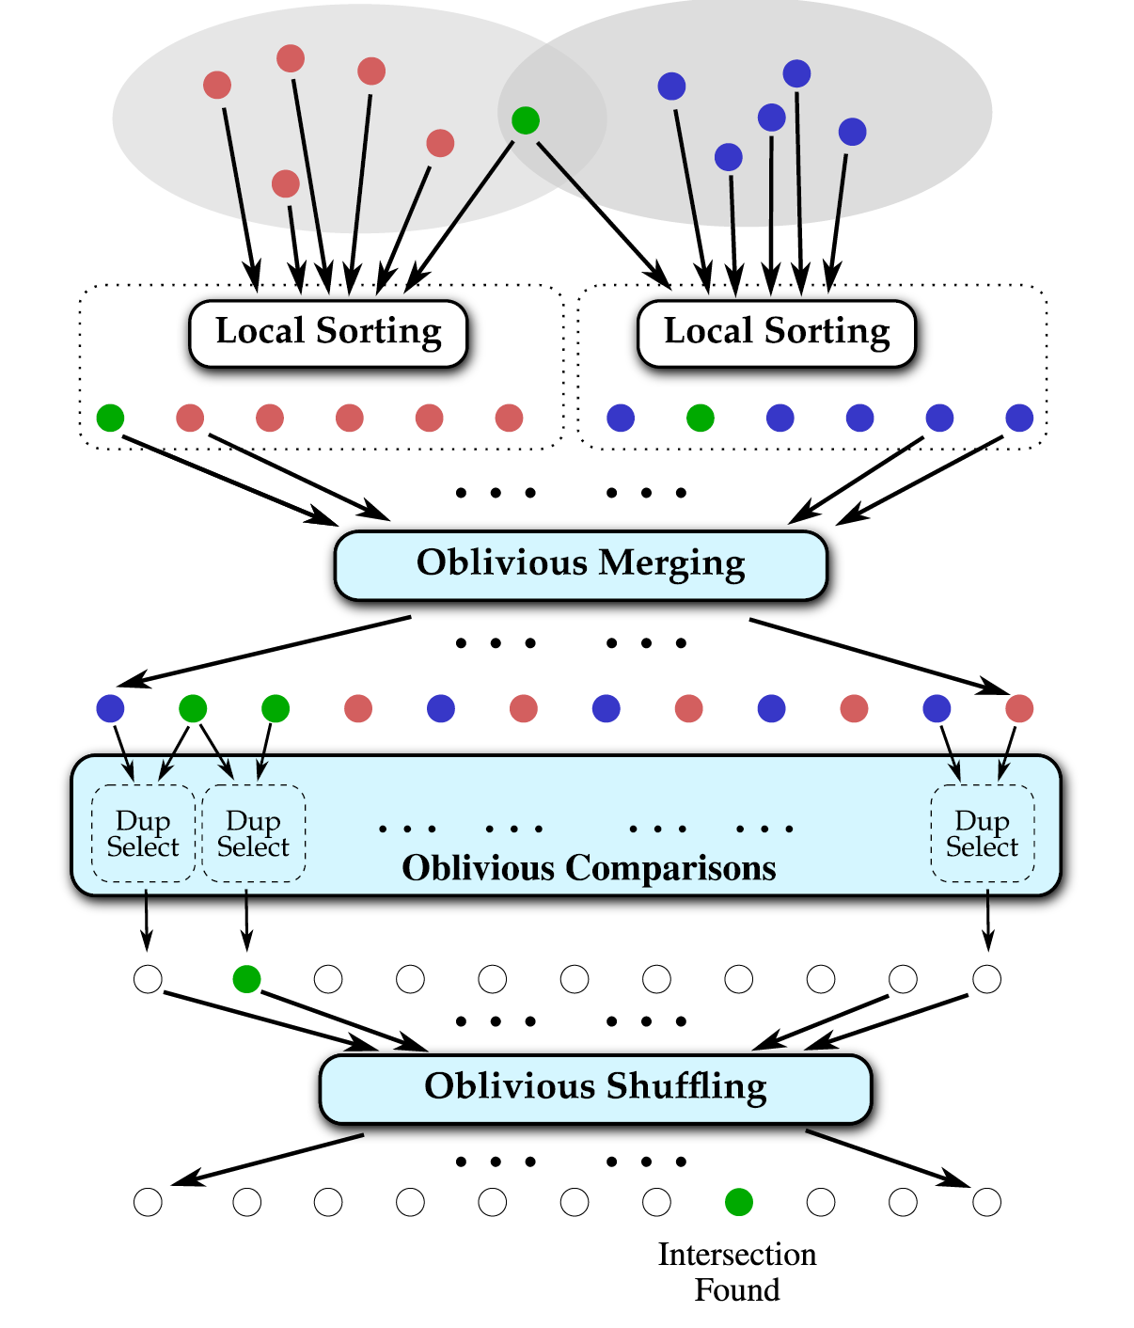

Sort-Compare-Shuffle design
Require only $Θ(nlogn)$ element comparisons.
Locally sort their own input set.
Three subtasks: Oblivious Merging, Oblivious Comparisons and Oblivious Shuffling.

Slide 16
The Frameworks for MPC

Slide 17
Introduction Of Main Frameworks
EMP-toolkit(C/C++)
2PC and MPC with GC; secure against semi-honest adversaries(EMP-sh2pc), and resistant against malicious parties(EMP-[ag2pc|m2pc|agmpc])
MP-SPDZ(Python)
MPC with garbled circuits or secret sharing; secure against malicious or semi-honest adversaries with dishonest or honest majority.
Swanky(Rust)
A suite of rust libraries for secure multi-party computation (currently includes oblivious transfer, garbled circuits, and private set intersection).
BGM in Go(Go)
The Implementation of the BGM MPC protocol in Go.

